Slide 1
PHISHING WEBSITE DETECTION by MACHINE LEARNING TECHNIQUES
SEMINAR REPORT (COSC 484)

Slide 2
FIDELIS WAIRIMU WAWERU REG_NO: EB1/32734/17 SUPERVISOR: DR MWATHI

Slide 3
INTRODUCTION
Phishing is the most commonly used social engineering and cyber attack.
Through such attacks, the phisher targets naïve online users by tricking them into revealing confidential information, with the purpose of using it fraudulently.
In order to avoid getting phished,
users should have awareness of phishing websites.
have a blacklist of phishing websites which requires the knowledge of website being detected as phishing.
detect them in their early appearance, using machine learning and deep neural network algorithms.

Slide 4
Of the above three, the machine learning based method is proven to be most effective than the other methods.
Even then, online users are still being trapped into revealing sensitive information in phishing websites.

Slide 5
OBJECTIVES
A phishing website is a common social engineering method that mimics trustful uniform resource locators (URLs) and webpages.
The objective of this project is to train machine learning models and deep neural nets on the dataset created to predict phishing websites.
Both phishing and benign URLs of websites are gathered to form a dataset and from them required URL and website content-based features are extracted.
The performance level of each model is measures and compared.

Slide 6
LITERATURE REVIEW:
History
The History of Phishing Started in The 1990s.
The Love Bug of 2000
Phishing Today
Types of Phishing.
Phishing Motives
Ways in Which Users Can Avoid Being Victims of Phishing.
Machine Learning-Based Methods
Different Tactics and Strategies in Designing Phishing Websites.
Phishing Attack Life Cycle
Planning
Collection
Fraud
Effects of Literature Review On Project

Slide 7
APPROACH
Below mentioned are the steps involved in the completion of this project:
Collect dataset containing phishing and legitimate websites from the open source platforms.
Write a code to extract the required features from the URL database.
Analyze and preprocess the dataset by using EDA techniques.
Divide the dataset into training and testing sets.
Run selected machine learning and deep neural network algorithms like SVM, Random Forest, Autoencoder on the dataset.
Write a code for displaying the evaluation result considering accuracy metrics.
Compare the obtained results for trained models and specify which is better.

Slide 8
Data Collection
APPROACH
Legitimate URLs are collected from the dataset provided by University of New Brunswick, https://www.unb.ca/cic/datasets/url-2016.html
The data is also available in my kaggle account.
https://www.kaggle.com/waawerufidelis/phishing-detection?select=5.urldata.csv
From the collection, 10,000 URLs are randomly picked
Phishing URLs are collected from open source service called OpenPhish which is a repository of active phishing sites. This service provides a set of phishing URLs in multiple formats like csv, json and excel that gets updated hourly.

Slide 9
FEATURE EXTRACTION
The following category of features are selected:
Address Bar based Features
Domain based Features
HTML & Javascript based Feature
Address Bar based Features considered are:
• Domian of URL
• Redirection ‘//’ in URL
• IP Address in URL
• ‘http/https’ in Domain name
• ‘@’ Symbol in URL
• Using URL Shortening Service
• Length of URL
• Prefix or Suffix "-" in Domain
• Depth of URL

Slide 10
FEATURE EXTRACTION - CONT
Domain based Features considered are:
DNS Record
Age of Domain
Website Traffic
End Period of Domain
HTML and JavaScript based Features considered are:
Iframe Redirection
Disabling Right Click
Status Bar Customization
Website Forwarding

Slide 11
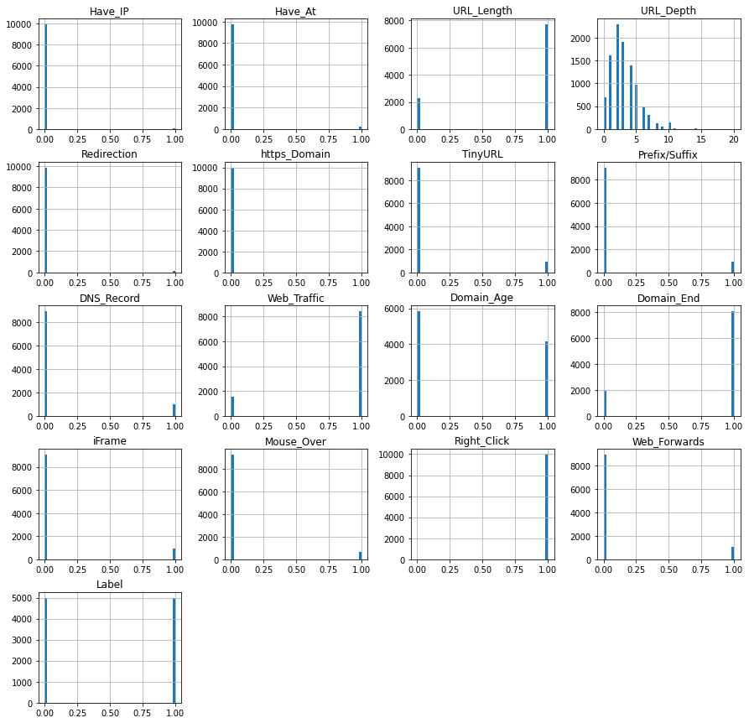

Slide 12
MACHINE LEARNING MODELS
This is a supervised machine learning task. There are two major types of supervised machine learning problems, called classification and regression.
This data set comes under classification problem, as the input URL is classified as phishing (1) or legitimate (0).
The machine learning models (classification) considered to train the dataset in this notebook are:
Decision Tree
Random Forest
Multilayer Perceptrons
XGBoost
Autoencoder Neural Network
Support Vector Machines

Slide 13
MODEL EVALUATION
The models are For the comparison below, it is clear that the XGBoost Classifier works well with this dataset as it has the highest train and test accuracy.
evaluated, and the considered metric is accuracy
 | ML Model | Train Accuracy | Test Accuracy
0 | Decision Tree | 0.812 | 0.820
1 | Random forest | 0.818 | 0.829
2 | Multilayer perceptron | 0.858 | 0.866
3 | XGBoost | 0.866 | 0.870
4 | SVM | 0.799 | 0.814

Slide 14
Working on this project is very knowledgeable and worth the effort.
Through this project, one can know a lot about the phishing websites and how they are differentiated from legitimate ones.
This project can be taken further by creating a browser extensions of developing a GUI.
These should classify the inputted URL to legitimate or phishing with the use of the saved model.

Slide 15
THANK YOU…..

